Slide 1

ELL-880 Social Network Analysis of Aviation Networks(India)
Submitted By :
Anand (2019EET2340)
ChandraGupta(2019EET2341)

Slide 2
Problem Statement
We plan to prepare a network and carry out analysis of Air Traffic across the whole India and also of a select few cities of the world
On this basis we will figure out which of the Airports are the most important ones based upon analysis of their centrality measure like degree and betweenness.
We can also try to find out bridges in Air Traffic which might need to be consolidated with more flights between those routes and also determine if extra bridges need to be created to control impact of route inaccessibility.
For example : Eyjafjallajökull volcano led to the disruption of over 100,000 flights and 10 million passenger journeys.
We also try and predict as to whether inter country relations can also be predicted based upon flight data availability

Slide 3
Problem Statement Continued
We also propose to find relation between the degree centrality of an airport and economic and political prosperity of the affliated city.
We also propose to find relation between the degree centrality of an airport and effect on bird migration.We tend to pre assume that these things are directly co-related but we would try to prove it with our studies

Slide 4
Links to Extract Data
We proposed and planned to use web crawlers to get data from various websites and then pre process them to obtain “from” “to” itinerary of flights.

Slide 5
Tentative Steps
Data Collection: Web Scrapping Across different sites.
Data Cleaning And Study with data of Bird migration ,Economics etc
Use different SNA Tools to visualize and analyse data

Slide 6
Data Extraction(Web Scraping)
Web scraping is the process of collecting structured web data in an automated fashion. It's also called web data extraction. Some of the main use cases of web scraping include price monitoring, price intelligence, news monitoring, lead generation and market research among many others.

Slide 7
Contd.
TOOL USED: SELENIUM
OPEN SOURCE
RUNS ON BROWSER
PYTHON
BROWSER : GOOGLE CHROME
DATA SOURCE: https://www.easemytrip.com/

Slide 8
Contd..
ENTIRE DATA ON SINGLE PAGE
NO CAPTCHA ( This helped us avoid getting caught in the clutter of adding plugins to remove these barriers).
We even scrapped data from net for airport co ordinates so that they can be pointed on during gephi visualization

Slide 9
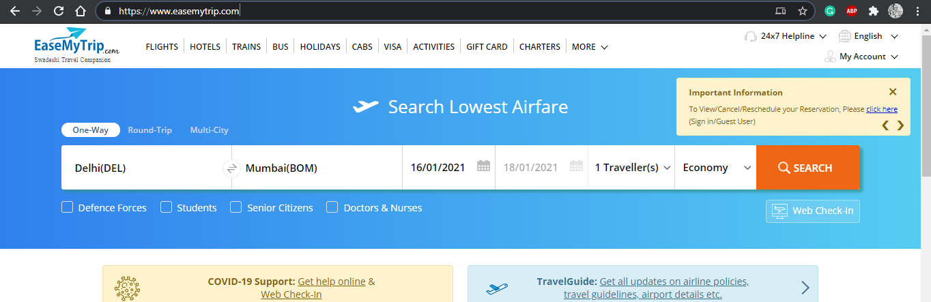
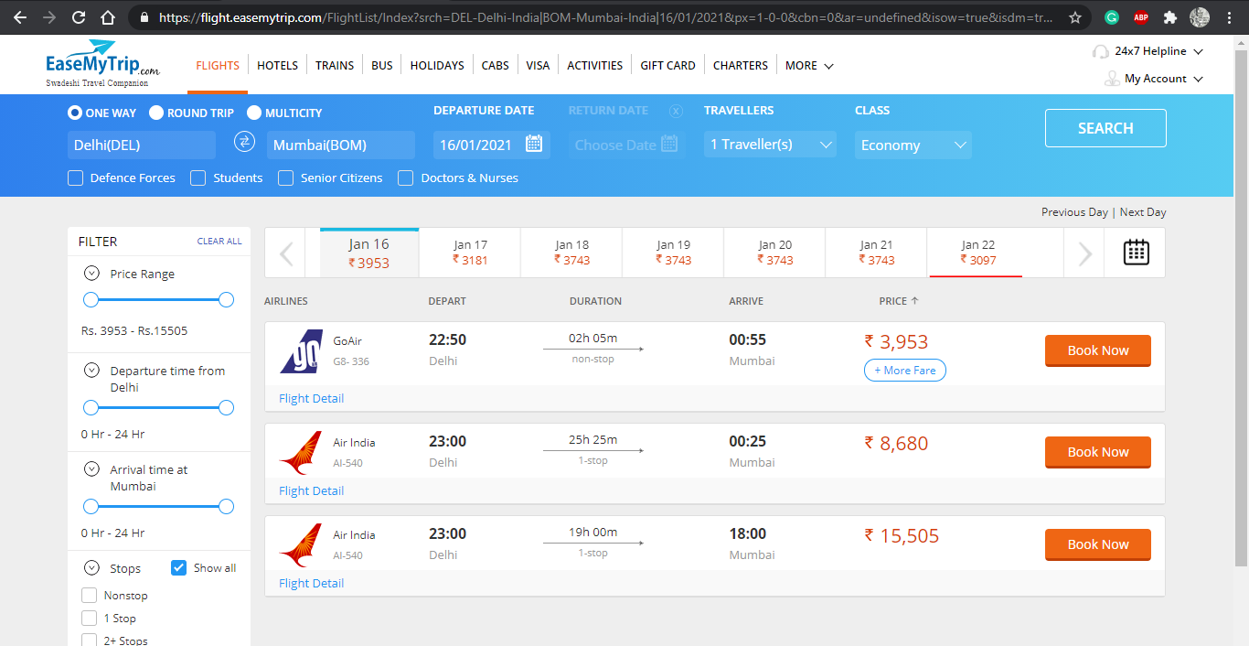
SOURCE
DESTINATION
DATE

Slide 10
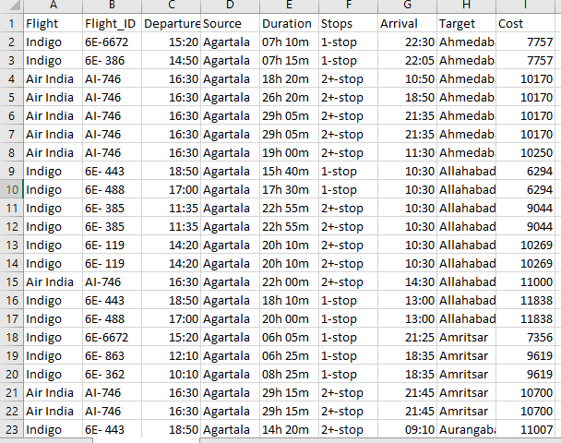
NETWORK DATA IN CSV FORMAT
NO. OF AIRPORTS :137
WORKING : 83

Slide 11
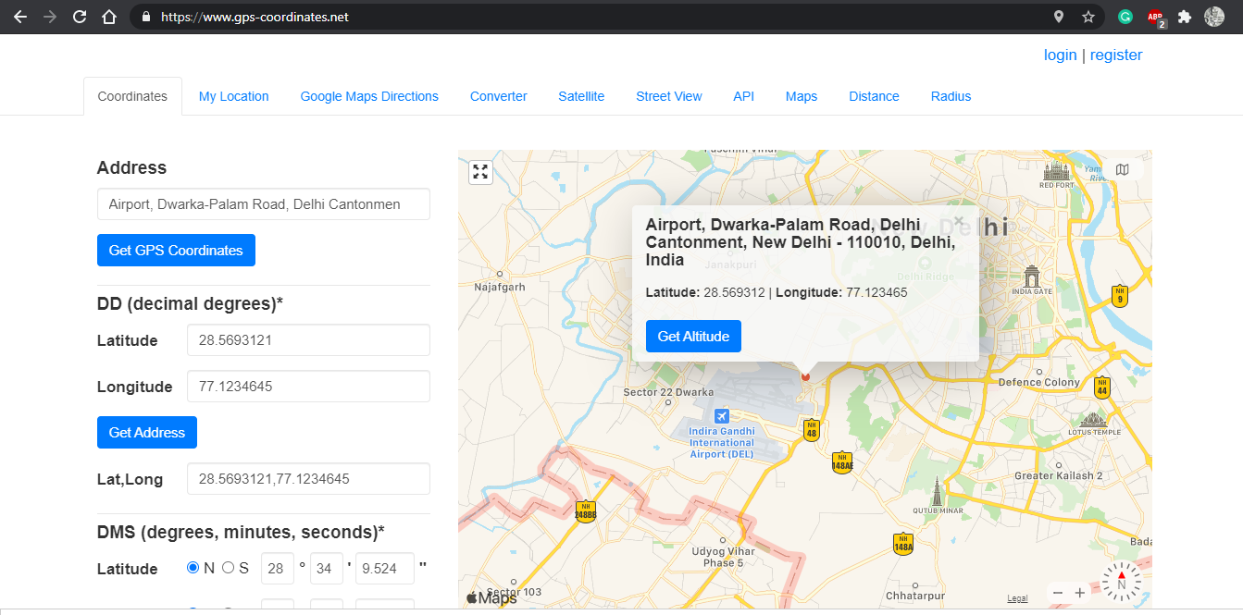
GPS Coordinates

Slide 12
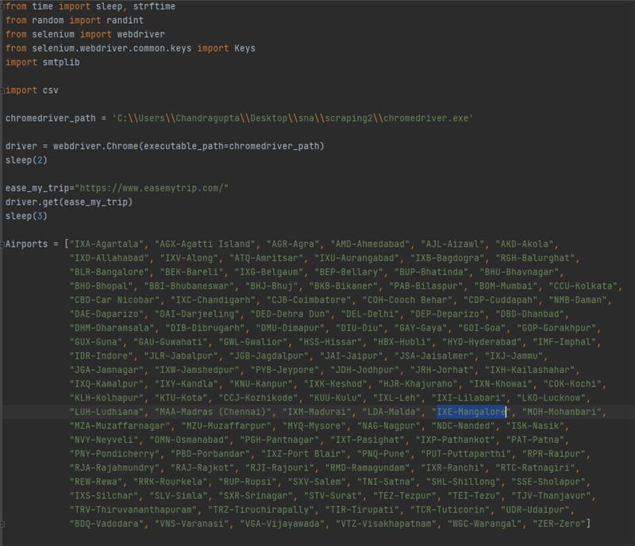
Code snippet of our scrapping code

Slide 13
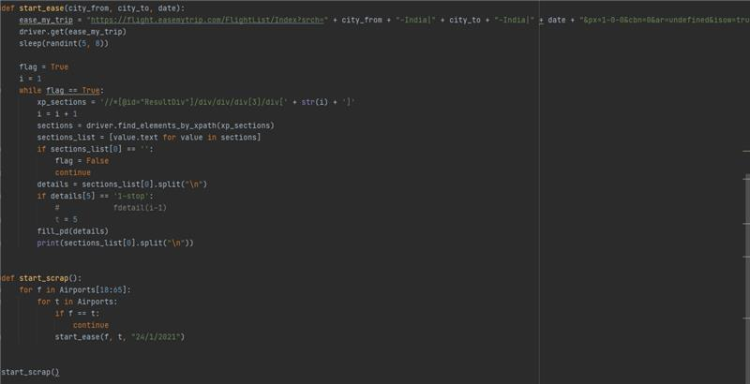
Contd..

Slide 14
Visualizations on Gephi
We have imported this data in gephi after some pre processing and figured out the centrality measures , modularity class , degree distribution of various aspects of the network.
We have also done path cost analysis as cheap or costly.
We have also in the done evaluations related to economic prosperity of the place, international relations and effect on some ecological aspects.

Slide 15
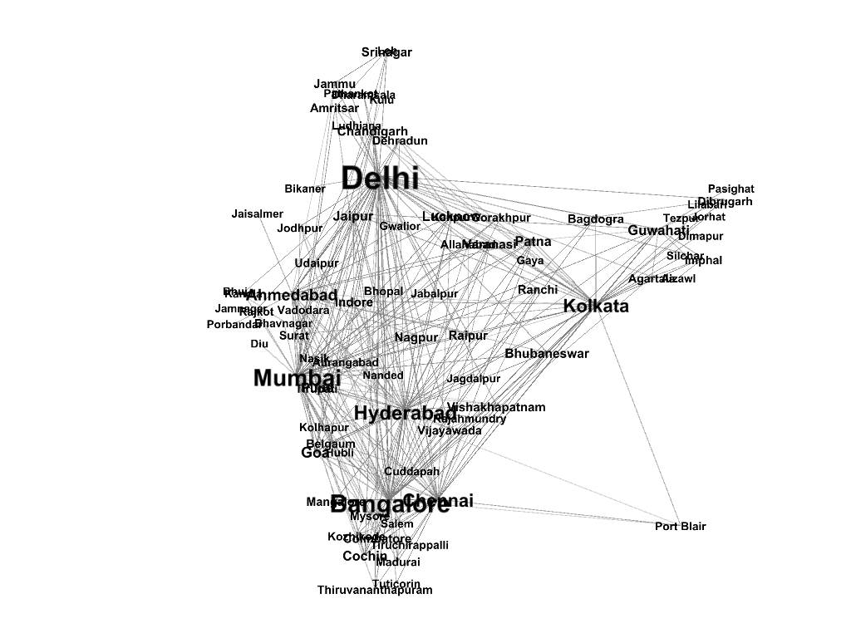
Non Stop Flights

Slide 16
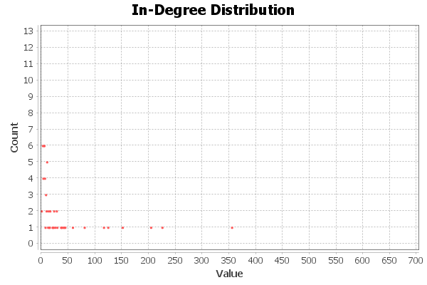
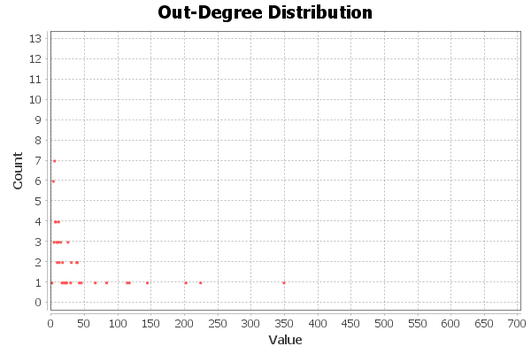
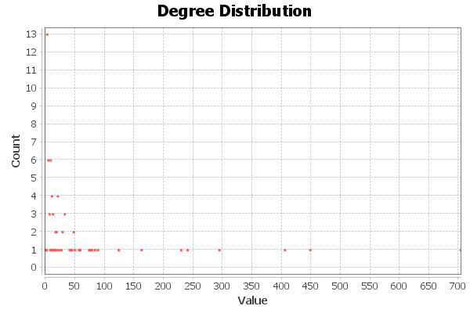
Degree Distributions

Slide 17
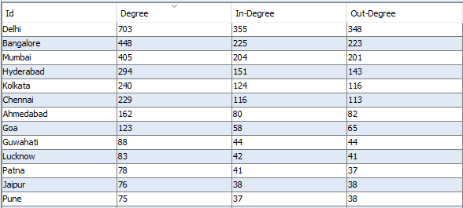
Degree Data

Slide 18
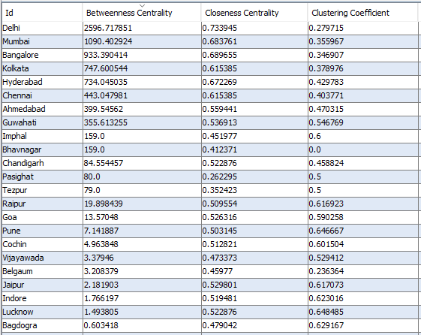
Charts representing Betweeness Centrality

Slide 19
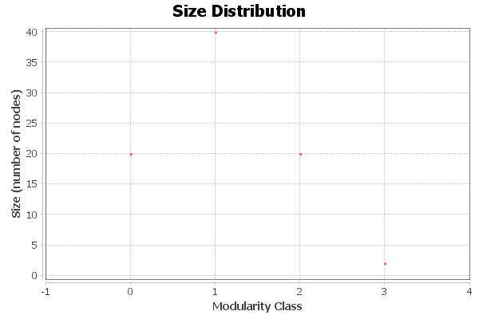
Modularity Class

Slide 20
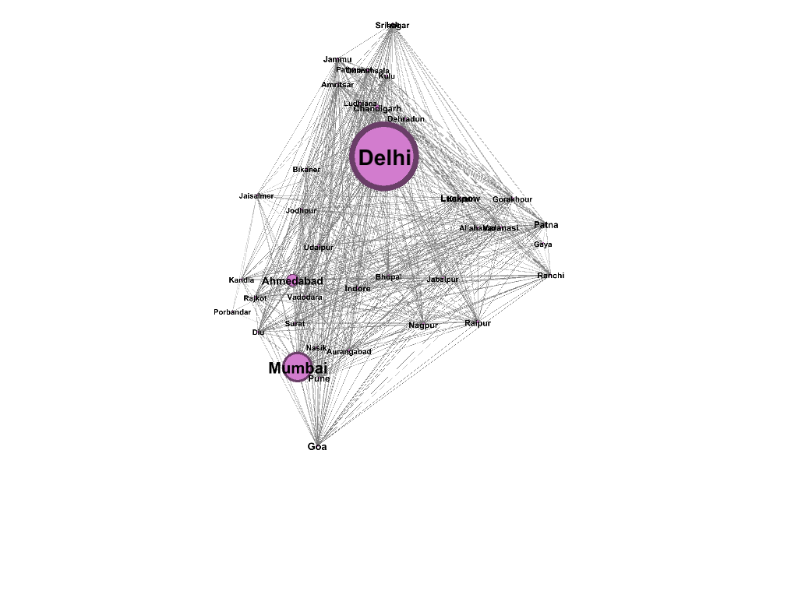
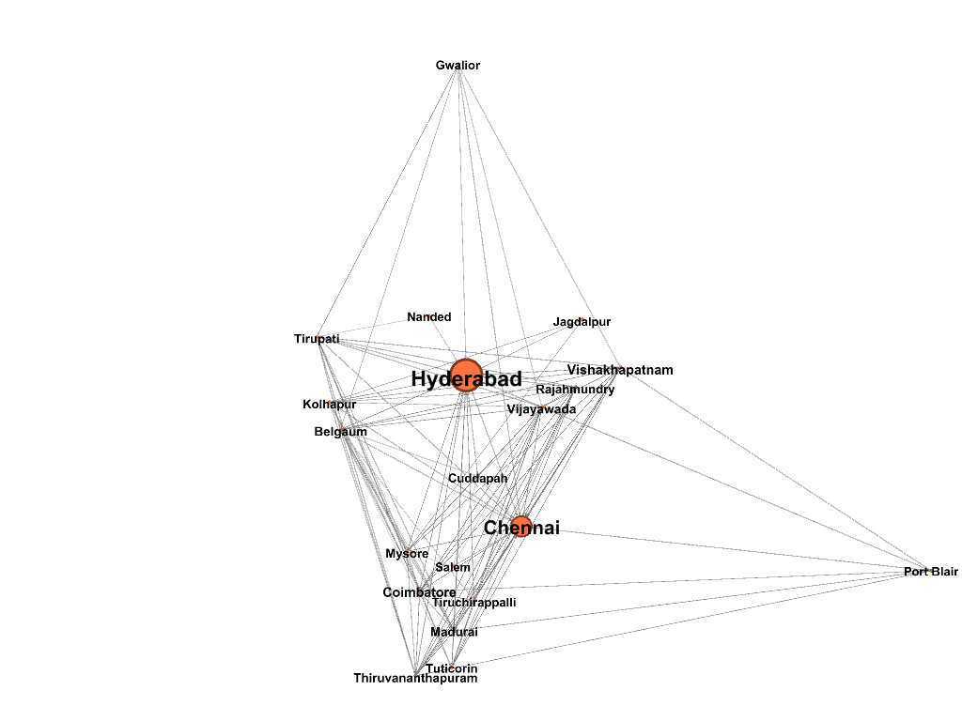
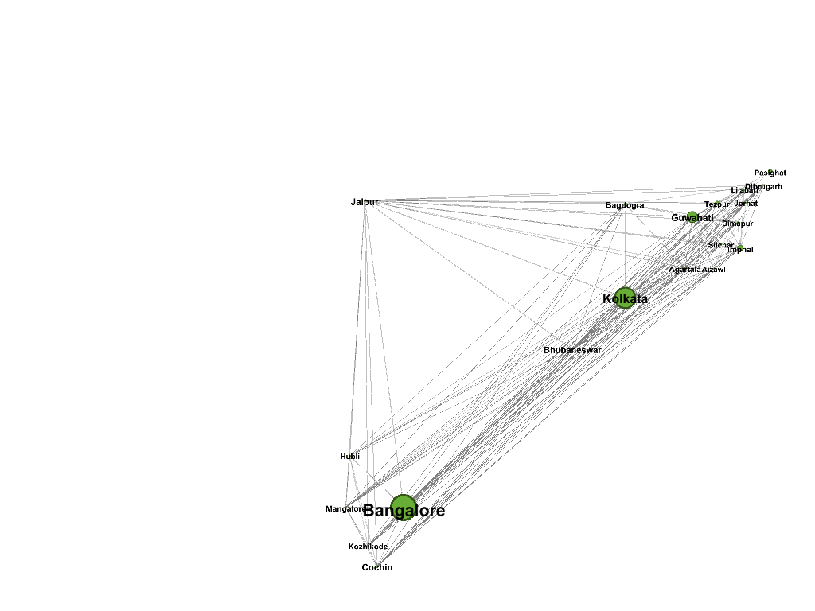
Modularity classes

Slide 21
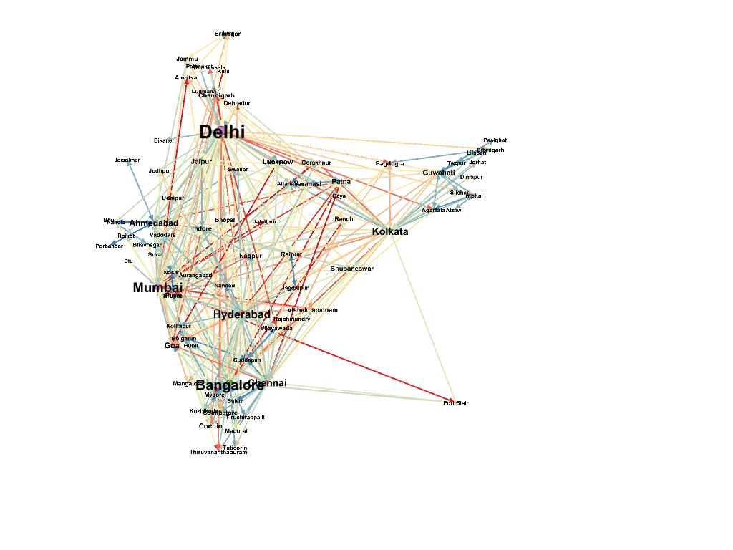
Price Indicators (Costliest red,Blue being cheapest)

Slide 22
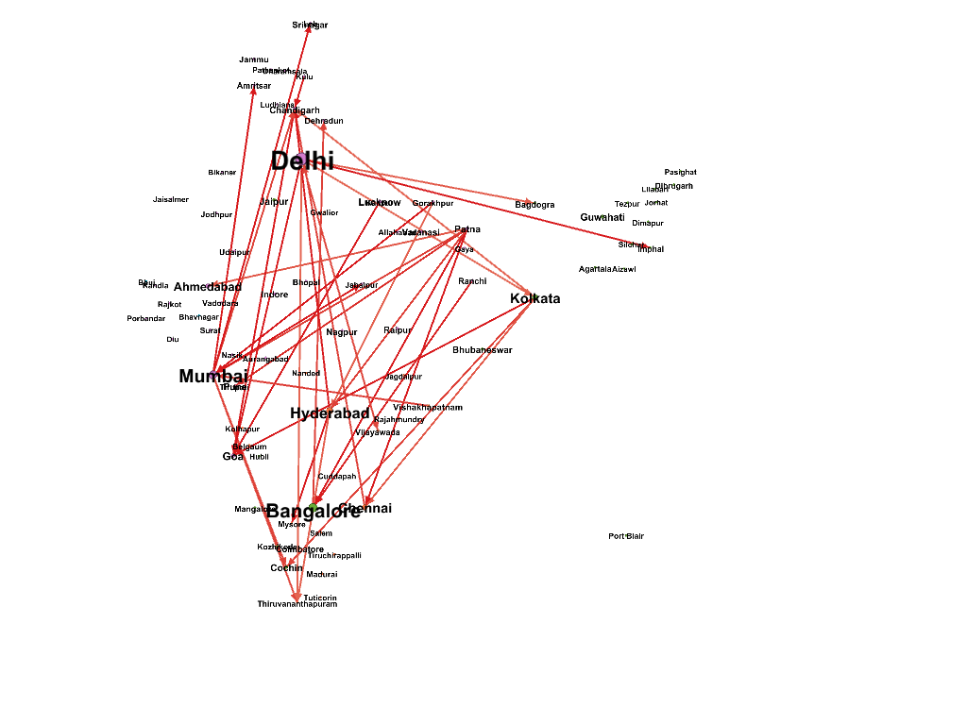
Flight Price > 10k

Slide 23
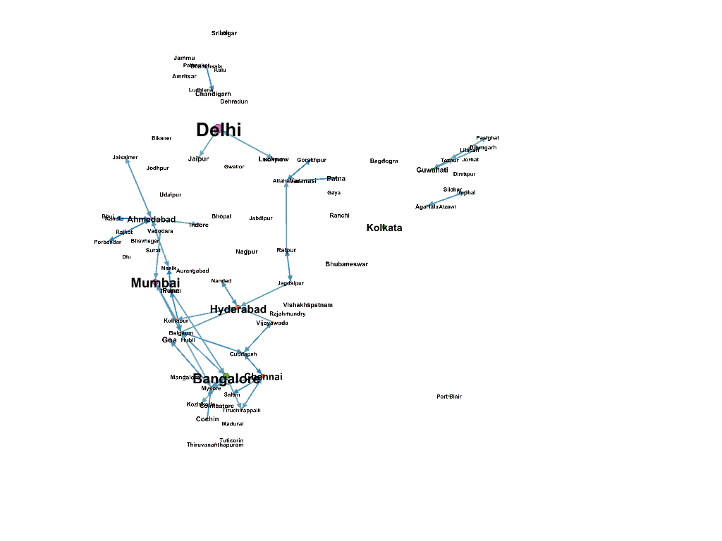
<3k(UDAN flights)

Slide 24
Few Observations
(Fig on left) atmost 15 flights 96.78 % (There are only max 15 flights between those routes)
Atleast 15 flight 3.22 % (More than 15 flights between them)

Slide 25
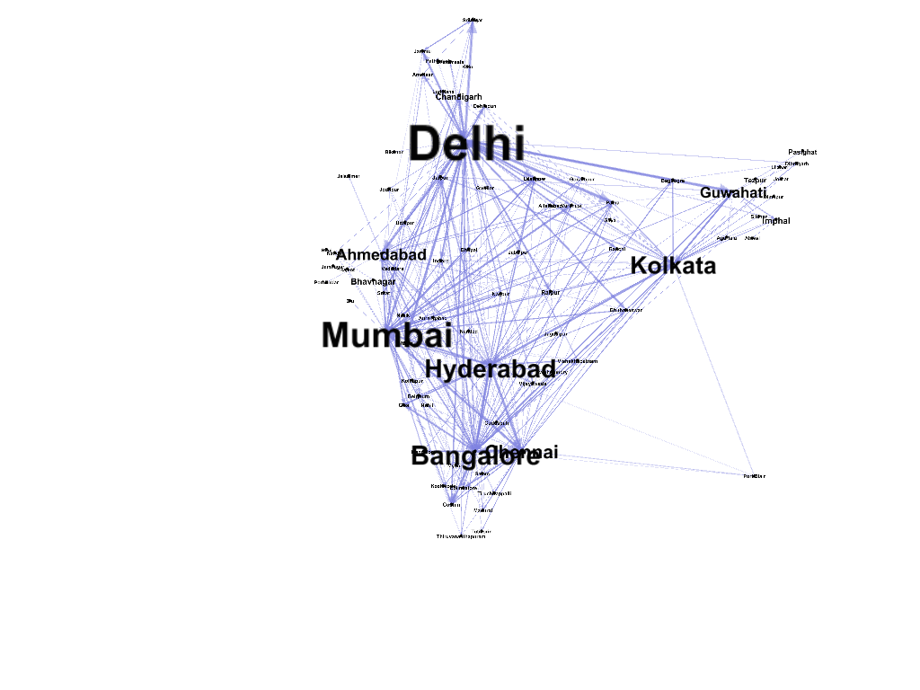
At most 15 flights routes

Slide 26
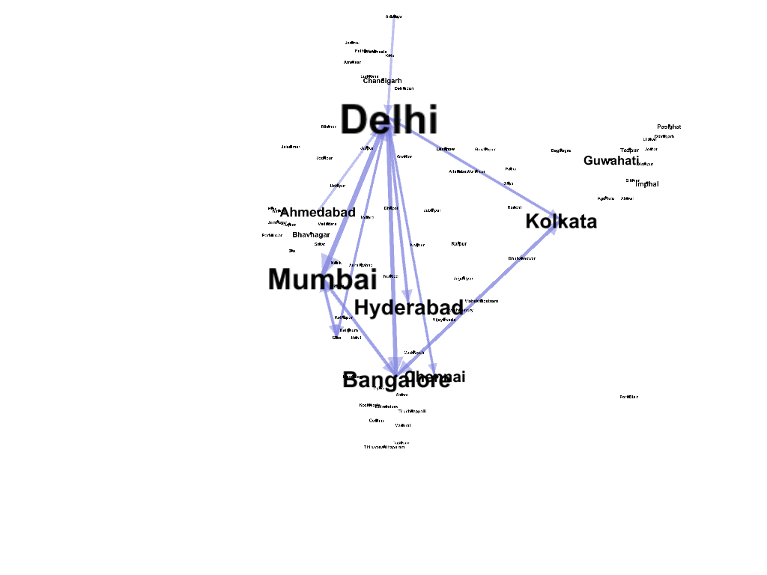
At least 15 flights

Slide 27
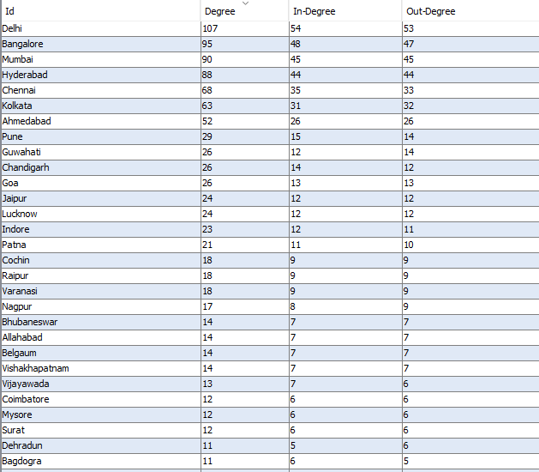
Contd…

Slide 28
UDAN
UDAN is a regional airport development and "Regional Connectivity Scheme" of GOI.
Total target current airport: 486
As per data released from AAI in June 2020
UDAN flights Operated | Total number of Pax carried in UDAN flight | No. of UDAN Pax seats sold | No. of Non UDAN Pax seats sold
86,425 | 47,00,698 | 27,36,843 | 19,61,018

Slide 29
Difficulties with UDAN :
We contacted AAI for datasets regarding airport footfalls and operational/running costs but were not fruitful because we had just one contact point who was stuck mainly with approvals of cost of running metrics.
Pointed -> Work done by Chandrasekhar et al.,2019 where they had acquired similar data from AAI but data was older by 3 years.
Data will be shown in a word doc but scatter plot will be shown here and conclusions will be shown here.

Slide 30
GDP and Air Traffic
City | Per Capita(In $) | Footfalls (m)
Mumbai | 4700 | 30
New Delhi | 4623 | 42
Kolkata | 3718 | 15
Bengaluru | 3375 | 23
Hyderabad | 2353 | 14.8
Chennai | 2514 | 14.21
Pune | 2456 | 6.98
Ahmedabad | 2771 | 7.6
Surat | 2610 | 1.21
Visakhapatnam | 2006 | 1.92

Slide 31
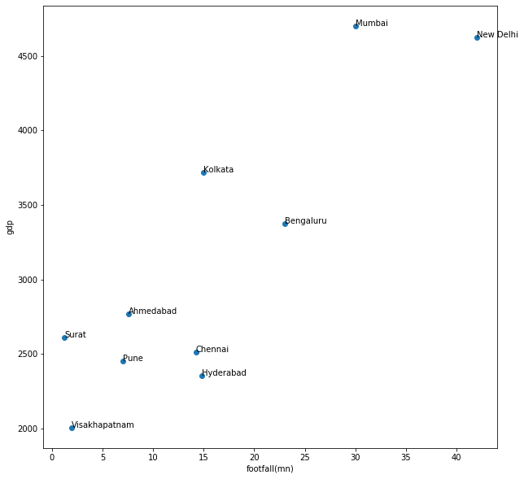
Conclusions : Footfalls as Marker of Economic Growth

Slide 32
Case Studies on International Relationship
Country relations can also be obtained from the data that we have scraped.
Poor relationships reflects less flights between countries.More than 130 fights operate between Indian cities and Tel Aviv wheras there is no flights between India and Pakistan.These are examples of strong liking and strong hatred towards each other.

Slide 33
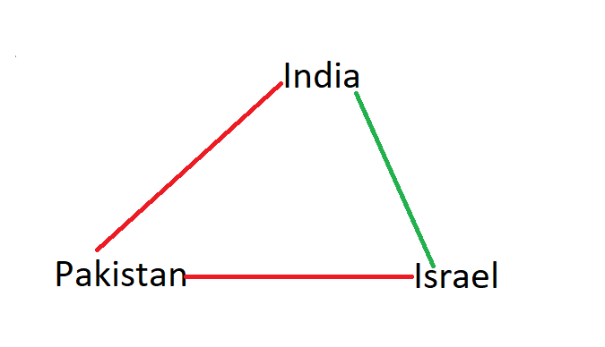
Contd..
Strongly Balanced Graph : As seen in class we saw that an unstable world will lead to wars . Unstability is more if in relationshio triangles we have 2 positive and 1 positive relationshiop.Its is bound to create a tension.
Stable Triad :
There is no flight operations between India and Israel to Pakistan.This is a stable order and it never changes.

Slide 34
Unstable Ties
Consider the case of UAE,Israel and India.India has better relations with both and needs to appease both countries to maintain relations from time to time.Ditto with India,US and USSR axis.
Anytime India tries to do a deal with US or USSR the other one tries to sanction it.
Recent Example : India was dared with Sanctions when it dealt with Russia over S-400 ‘Triumf’ Air Defence Systems.
India US and Russia Flight patterns show similar results.Although US and Russia flights are not no existent but they do not reflect true potential between two behemoth economies and seems more like a token gesture.

Slide 35
Case Study : Flight Competition
We had assumed at the beginning of this project that flights might have effect on bird migration but during our research we found this to not to be completely correct.
The only effects are changes in energy conversion, time of food intake [Norbert Kempf],increase in heart rate.
Disturbed reactions to flight reported for other waterfowl, great bustards, predatory birds and crows.

Slide 36
Contd..
They have found that bird hits cause damage to the tunes of billions of $ to aviation industry on upkeep and maintenance.
Wetland reclamation efforst have also led to aggravated levels of dangers.
Ironically BIAL has advertised for an aviary for its new terminal so that bird population which has bewilderingly increased in its airports can be kept in check.

Slide 37
BIAL
The grasslands on the opposite side of the airport takes care of the insect food that the sparrows may need to feed its young ones. Constant supply of food from the eateries offer an important source of food.
Sparrows are an important species at BIAL.

Slide 38
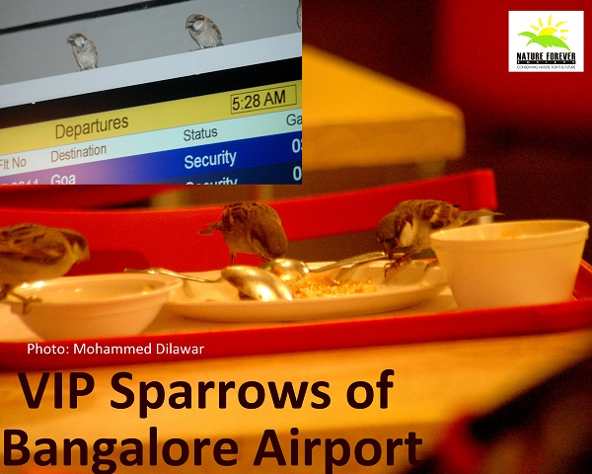

Slide 39
Conclusions
Birds suffer physiological and other problems due to increased airline activities.Most of it is in vicinity of the Airport as most birds indigenous to our country do not fly at such great heights where Airlines cruise.
Took 100’s of Photographs from https://ebird.org/india/home but nowhere in their blogs this issue of migration has been pointed out.
Hazing and scaring using multiple frequency sounds as well as other techniques are used to keep birds away and aviary must be a smart choice

Slide 40
Cheapest Route Evaluation
We plan to provide information through our visualizations to include cheapest route information for passengers by using Flight Fare Information as weights.
It might help people when travelling is more important than travel time.
We plan to also include information of short distance train journeys using the same mechanism.
We can also combine hotel and other information in the package based upon what is our criteria of travel

Slide 41
Conclusions :
Regional Airports in India are unsustainable because of extremely low footfalls and almost being outliers in civil aviation ecosystems.
Most airports are financially unstable currently
The breakeven point changes 0.8 million passengers in 2014-15 to 0.6 million passengers in 2016-17. Most regional airports in the sample have more than 0.5 million passengers per annum and this paves way for smaller and upcoming airports looking for incentive schemes to attract airlines.
We therefore conclude that schemes like UDAN will surely bring about economic success to areas which were not connected well by air traffic before.
Handle pandemic related information.

Slide 42
Contd..
Footfalls and GDP of a region follow a vicious circle.
The GDP of a region permits region affords it a regional airport which in turn increases the GDP of a region through the fastest mode of accessibility which in turn helps push the GDP further.
It helps take a region take the next leap in development and the faster the breakeven point in an airport development reaches better it is.
Betweenness centrality and closeness centrality gives us information as to who is most connected and as to who can transmit data very fast.
So if it’s a pandemic situation our first step should be to target cities with more closeness centrality

Slide 43
References
https://www.sciencedirect.com/science/article/pii/S209252121730041X[[Analysis of the Air Transport Network Characteristics of Major Airports]
A Set of Measures of Centrality based on Betweenness by L.C. Freeman
https://www.fai.org/sites/default/files/documents/ln_3-1_aircraft_effects_on_birds.pdf
https://www.aai.aero/sites/default/files/traffic-news/Aug2k19Annex3.pdf
Breakeven Passenger Traffic for Regional Indian Airports K Chandrashekhar Iyera , Soumya Jain
https://www.aai.aero/en/corporate/resources
https://www.natureforever.org/blog/2014/01/21/vip-sparrows-of-bangalore-airport/
https://en.wikipedia.org/wiki/List_of_Indian_cities_by_GDP_per_capita

